Slide 1
Composite Design Pattern
By: Hisham Hussein
CIS 476-002 Online

Slide 2
Intent-What is Composite Design Pattern
Composite pattern describes a group of objects that is treated the same way as a single instance of the same type of object
Composite lets clients treat individual objects and composition of objects uniformly
Intent
the intent of a composite is to “compose” objects into tree structures to represent part-whole hierarchies
When you want clients to ignore the difference between parts and wholes( individual objects and compositions of objects)
Recursive composition
Directories contain entries, each of which could be a directory."

Slide 3
Motivation
The motivation happens when application needs to manipulate a hierarchical collection of "primitive" and "composite" objects.
Processing of a primitive object is handled one way, and processing of a composite object is handled differently.
Having to query the "type" of each object before attempting to process it is not desirable.

Slide 4
Motivation cont…
When dealing with Tree-structured data, programmers often have to discriminate between a leaf-node and a branch. This makes code more complex
Solution
The solution is an interface that allows treating complex and primitive objects uniformly.
In object-oriented programming, a composite is an object designed as a composition of one-or-more similar objects, all exhibiting similar functionality.
For example, if defining a system to portray grouped shapes on a screen,
it would be useful to define resizing a group of shapes to have the same effect (in some sense) as resizing a single shape.

Slide 5
When to use Composition
If programmers find that they are using multiple objects in the same way, and often have nearly identical code to handle each of them, then composite is a good choice
Composite should be used when clients ignore the difference between compositions of objects and individual objects.
When application needs to aggregate data across a hierarchy.
When application wants to treat composite and individual objects uniformly.
Real life example:
Building consolidate view of a customer’s account in bank (i.e. customer’s portfolio)
Building general ledgers
Computer/network monitoring applications

Slide 6
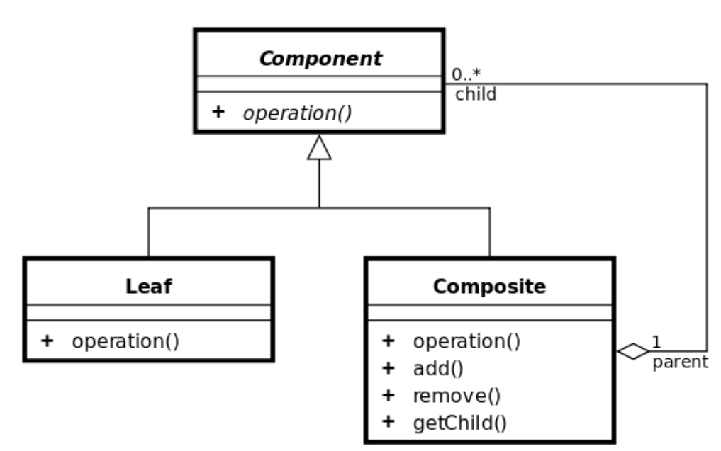
Structure
Default Composite Structure
Component
is the abstraction for all components, including composite ones
declares the interface for objects in the composition
Leaf
represents leaf objects in the composition
implements all Component methods
Composite
represents a composite Component (component having children)
implements methods to manipulate children
implements all Component methods, generally by delegating them to its children

Slide 7
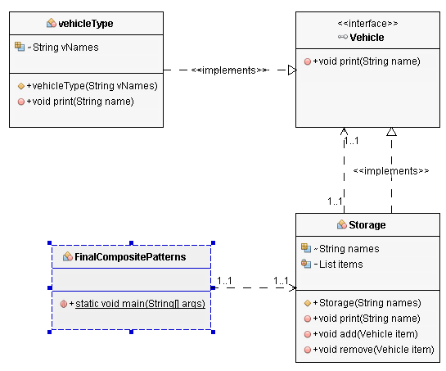
Demo-Structure cont…

Slide 8
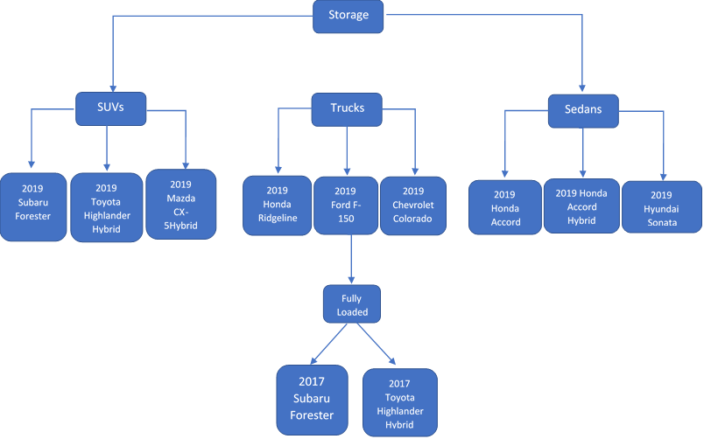
Demo-Structure cont…

Slide 9
Consequence
Can make your design too general
Since its easy to add new components it is hard to restrict the components of a composite
Composite doesn’t support using the type system to support these constraints for you, since all components have the same base type.
Makes it easier to add new components
Newly defined primitives or composites will automatically with existing structures and client code.
When a client expects a primitive it can also take a composite.

Slide 10
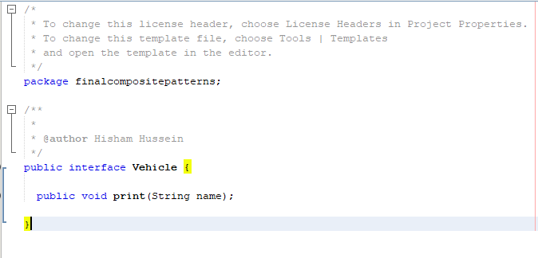
Code-demo
Vehicle interface

Slide 11
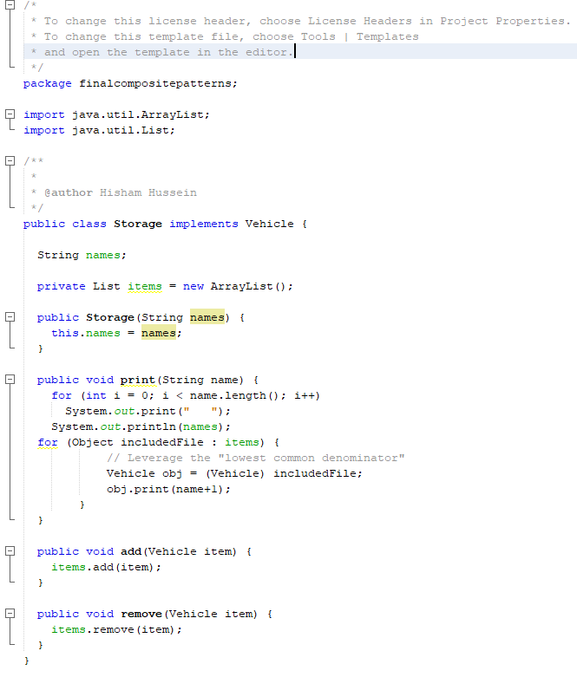
Code-demo cont…
Storage class

Slide 12
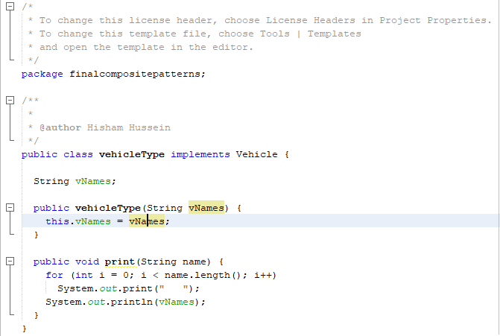
Code-demo cont…
vehicleType class

Slide 13
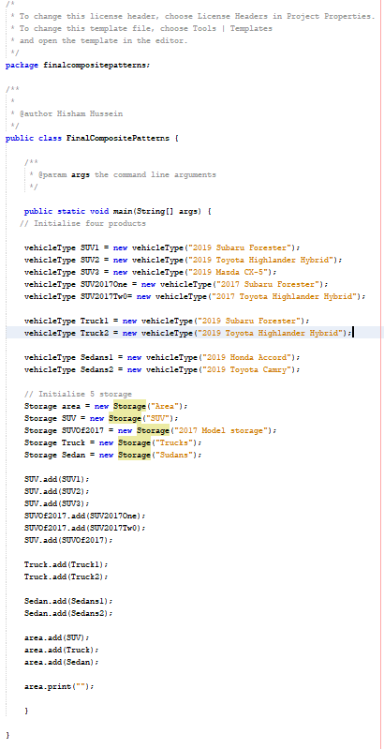
Code-demo con…
FinalCompositePattern-main()

Slide 14
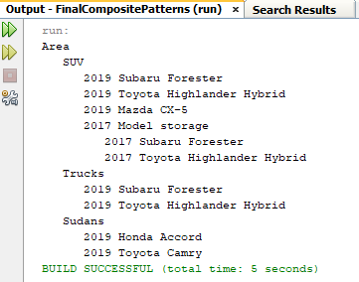
Code-demo con…
Output

Slide 15
YouTube link
https://www.youtube.com/watch?v=rIqOI4mYSM4&feature=youtu.be

